Slide 1
Wild Dundee: Where People and Nature Thrive

Slide 2
House-keeping
Feel free to have cameras on or off.
Please turn microphones off during presentation.
There will be time for questions at the end.
Your hosts today are Meera and Hope.

Slide 3
Same tree. Different Experiences.
This is a nice place to sit
I love this tree, it's so straight and tall
I love all the different colours of brown, green, red
I don’t think I’m supposed to go there

Slide 4
Embedding intersectionality into practice
Wild Dundee > ScotLINK
Intersectionality helps us understand how overlapping aspects of identity - like gender, race, class, trauma history, or disability - shape a person’s experiences.

Slide 5
Understanding the landscape
Where people and nature thrive
How can nature be woven into daily life?
How do we meet people where they are?
How do we empower a more diverse community to act for nature?

Slide 6
The disconnect
Nature is a luxury
Different types of greenspaces – different rules?
Barriers & exclusions to participation

Slide 7
Barriers
Gender & Culture
Mental ill-health & recovery
Stereotyping, assumptions, discrimination
Meeting people where they are
Building relationships
Creating structure, purpose
Our Response

Slide 8
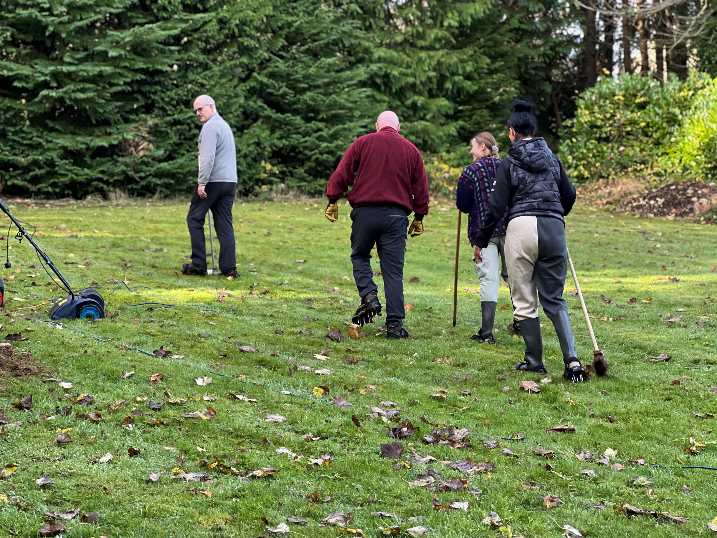
Nature Recovery
“I haven’t done this in years… to work! I’ve not worked in 4 years… to have this sense of purpose, it's great!”

Slide 9
Garden designs

Slide 10
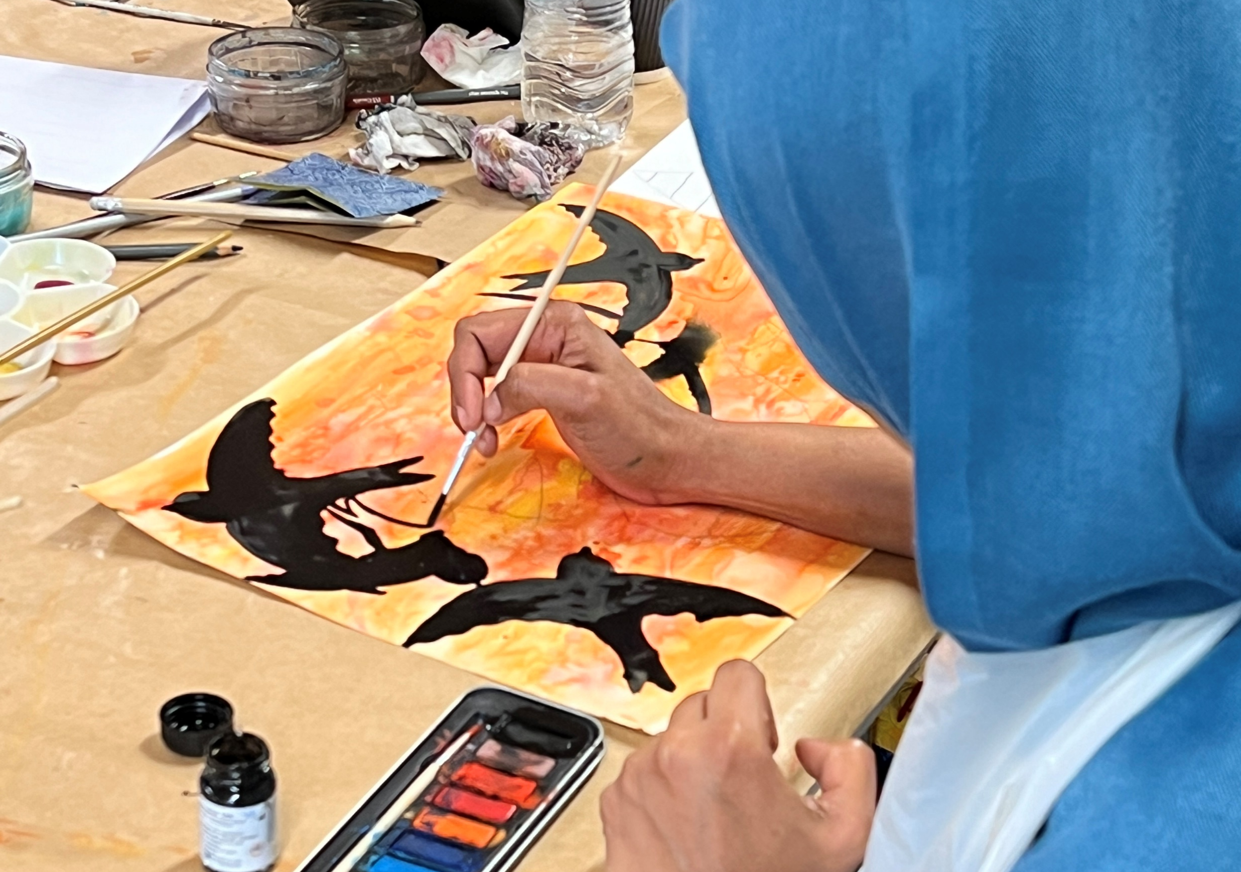
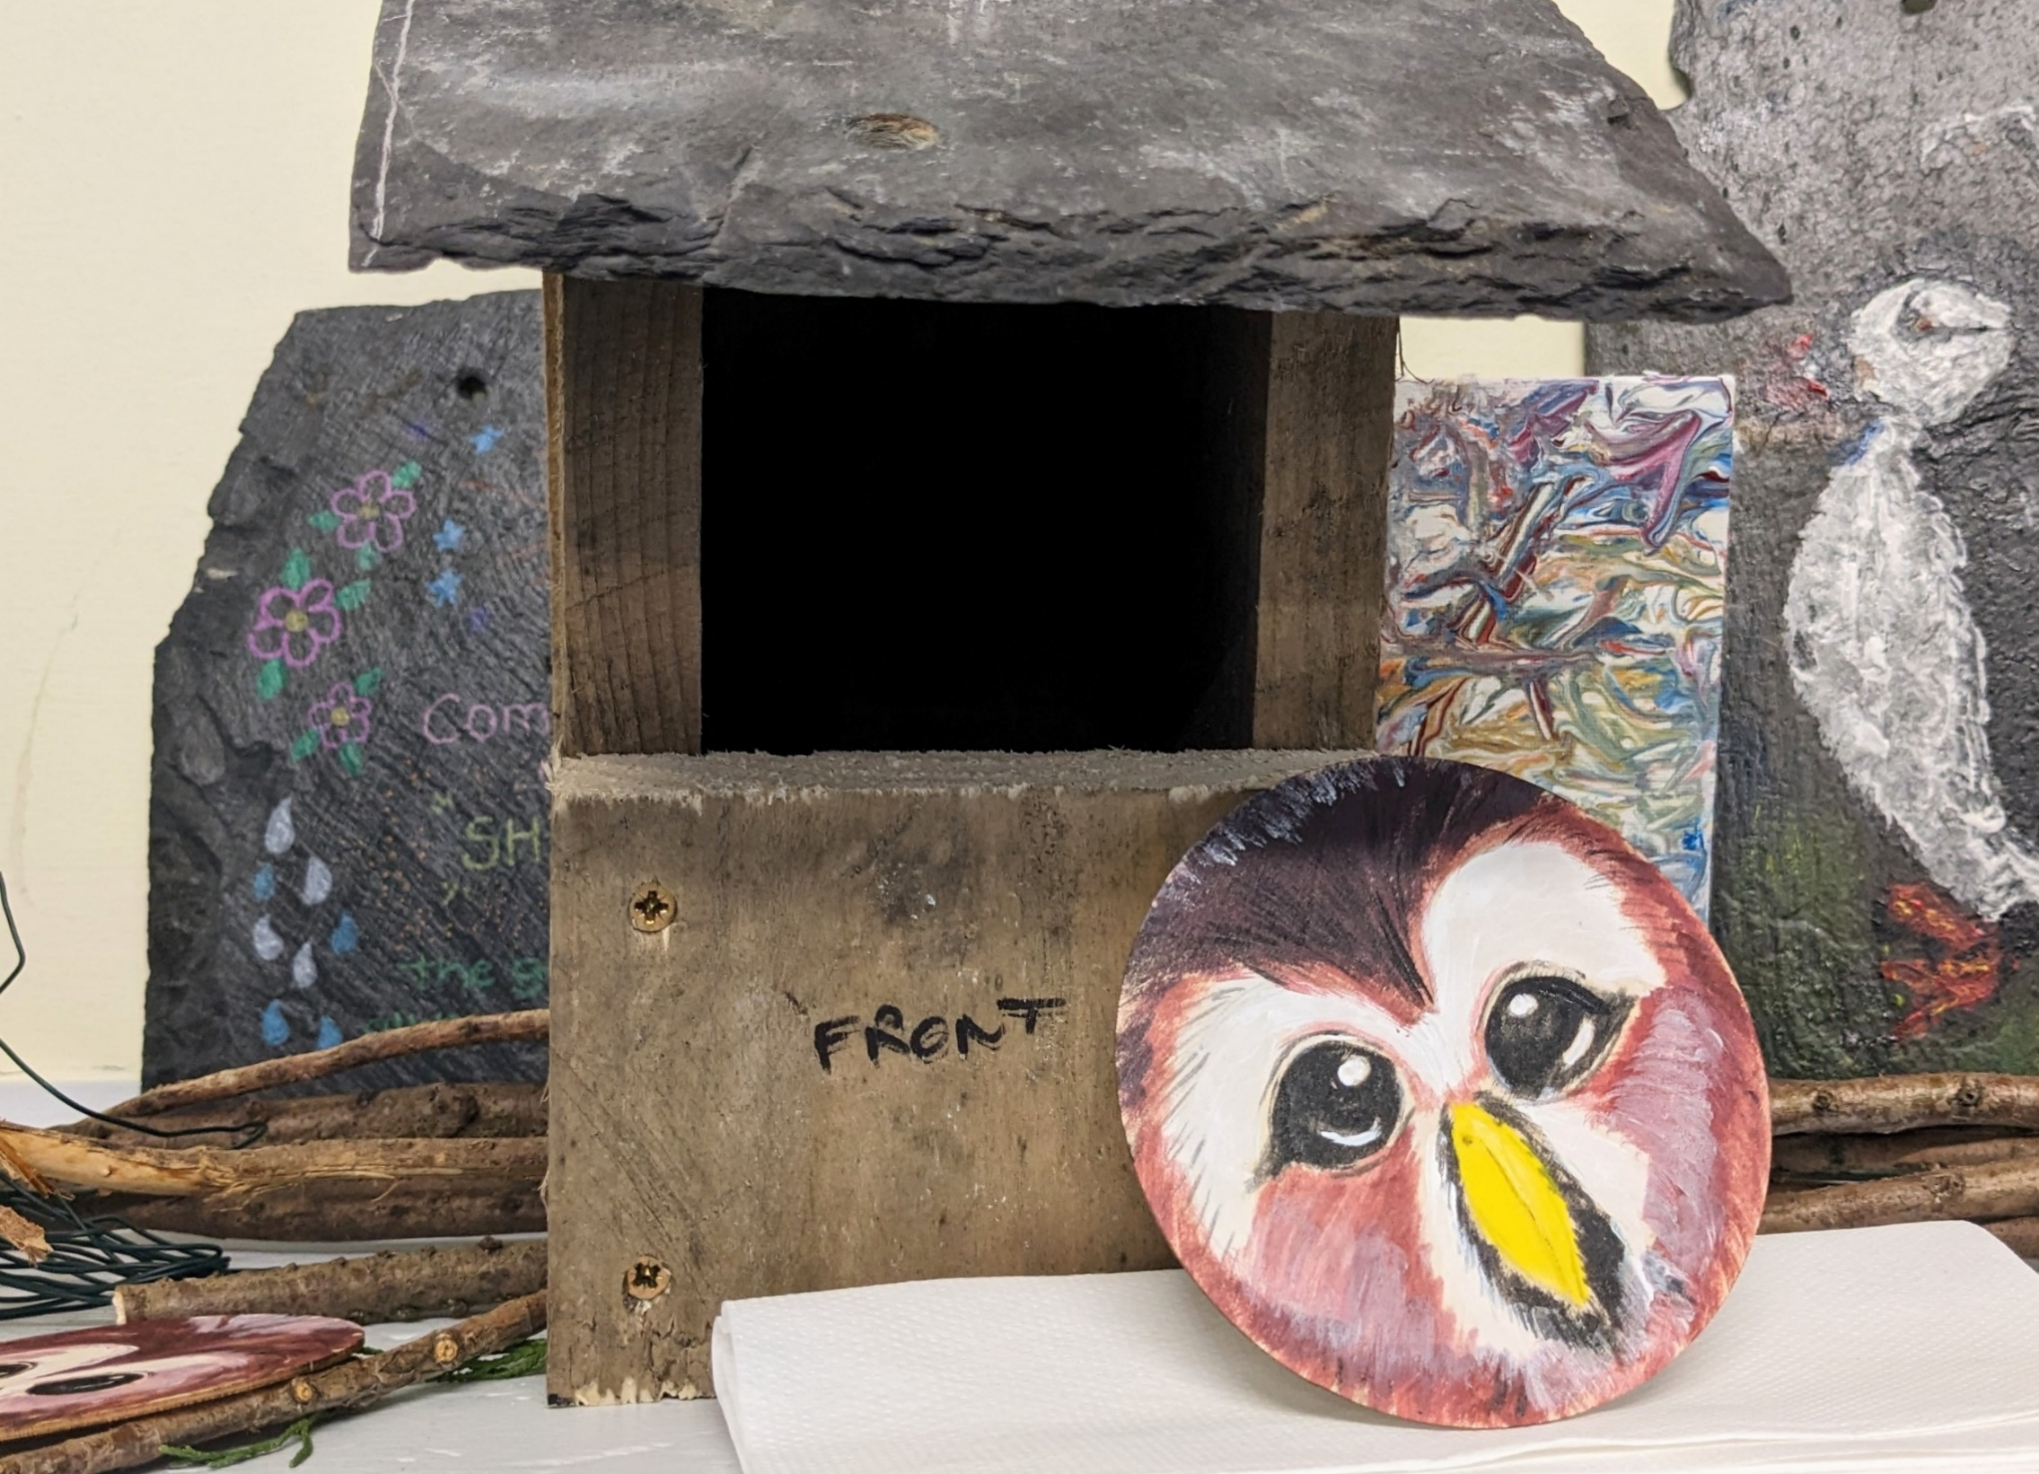
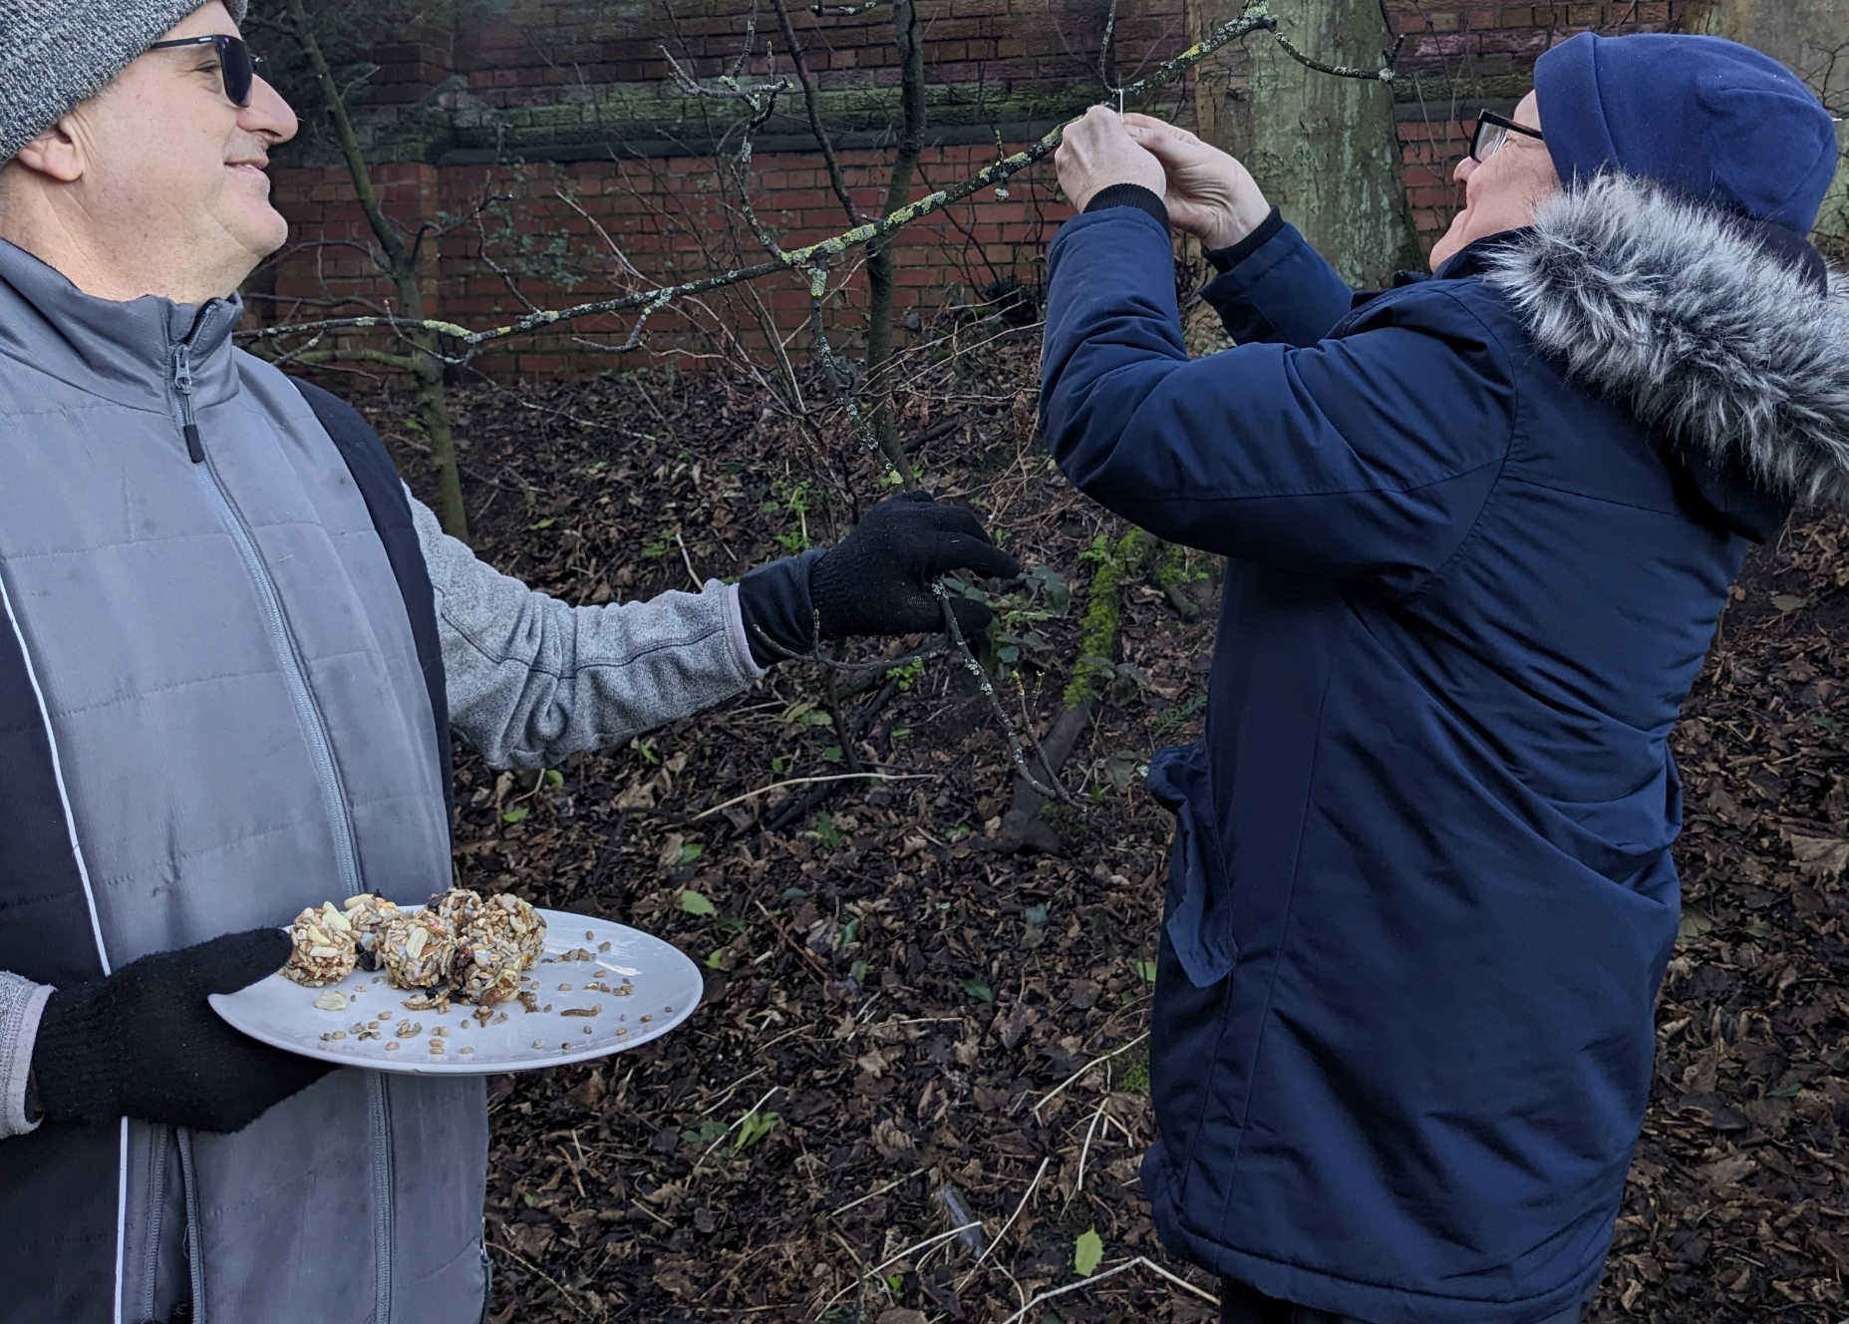
What we’re doing…
Addiction Recovery
Mental health & greenspace
New Scots & inclusion
Nature programme designed with and for people.
Trauma-informed approaches matter. Sensory activities, choice, autonomy.
Connecting stories of migration, storytelling, place-finding and place-making.

Slide 11
Practical Strategies
Engagement with nature should have purpose and be relevant!
Co-creation, not just consultation
Flexible and adaptable programming
Storytelling and representation

Slide 12
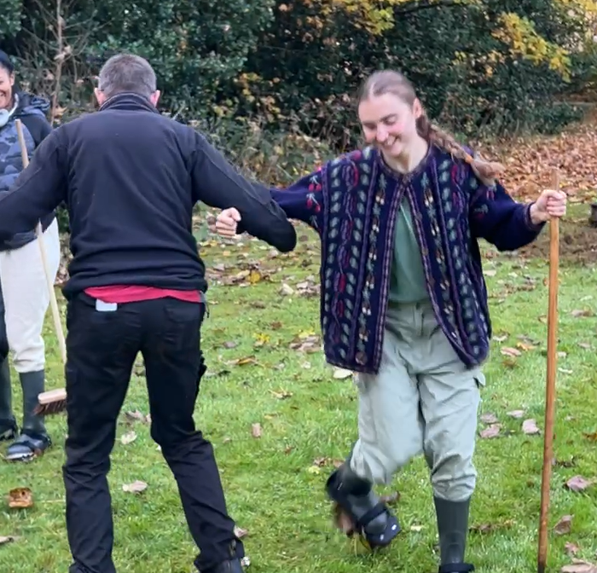
We are not the experts!!
“How do we get people to care about and act for nature?!”
“What does caring look like to them and how can we support?”

Slide 13
We’re still learning…
Are we listening well enough?
Are we reflecting the needs of all our communities?
Are we challenging the things that continue to exclude?
Image credit: Scottish Refugee Council

Slide 14
What does success look like?
Nature is part of every recovery journey.
Building community ownership and long-term engagement.
A city where people and nature thrive.

Slide 15
Nature doesn’t exclude, and nor should we

Slide 16
Any questions?
Hope.busak@rspb.org.uk
Meera.inglis@rspb.org.uk

