Slide 1
LINK advocacy training 2024
Session 1:
Introduction to advocacy

Slide 2
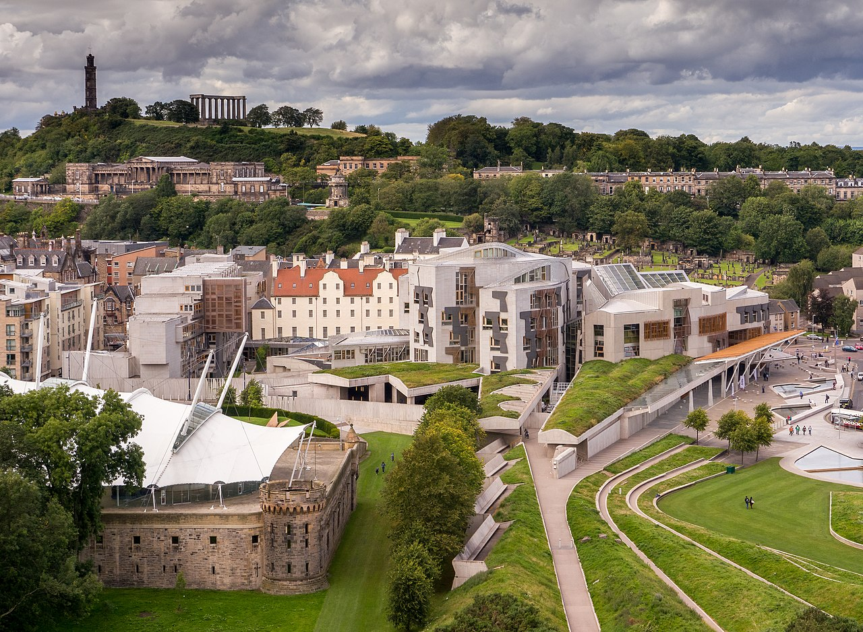
The basics…
129 MSPs elected – 73 constituency, 56 regional list
Cabinet Secretaries and Ministers form the Scottish Government
Other MSPs scrutinise the Government, including through Committee system

Slide 3
The basics…
129 MSPs elected – 73 constituency, 56 regional list
Cabinet Secretaries and Ministers form the Scottish Government
Other MSPs scrutinise the Government, including through Committee system
Parliament
Government
Public bodies

Slide 4
Parliament
Government
Public bodies
Approve legislation and budgets
Scrutinise the Scottish Government
Propose legislation and budgets
Responsible for day to day running of public services
Deliver public services
Accountable but arms-length of Ministers

Slide 5
Parliament
Government
Public bodies
Rural Affairs and Islands Committee
Net Zero, Energy and Transport Committee
Mairi Gougeon MSP
Cabinet Secretary for Rural Affairs, Land Reform and Islands
Mairi McAllan MSP
Cabinet Secretary for Net Zero and Energy
Jim Fairlie MSP Minister for Agriculture and Connectivity
Gillian Martin MSP
Minister for Climate Action
NatureScot
Scottish Environment Protection Agency (SEPA)
Forestry and Land Scotland
Scottish Forestry
Cairngorms National Park Authority
Loch Lomond and The Trossachs National Park Authority
Environmental Standards Scotland

Slide 6
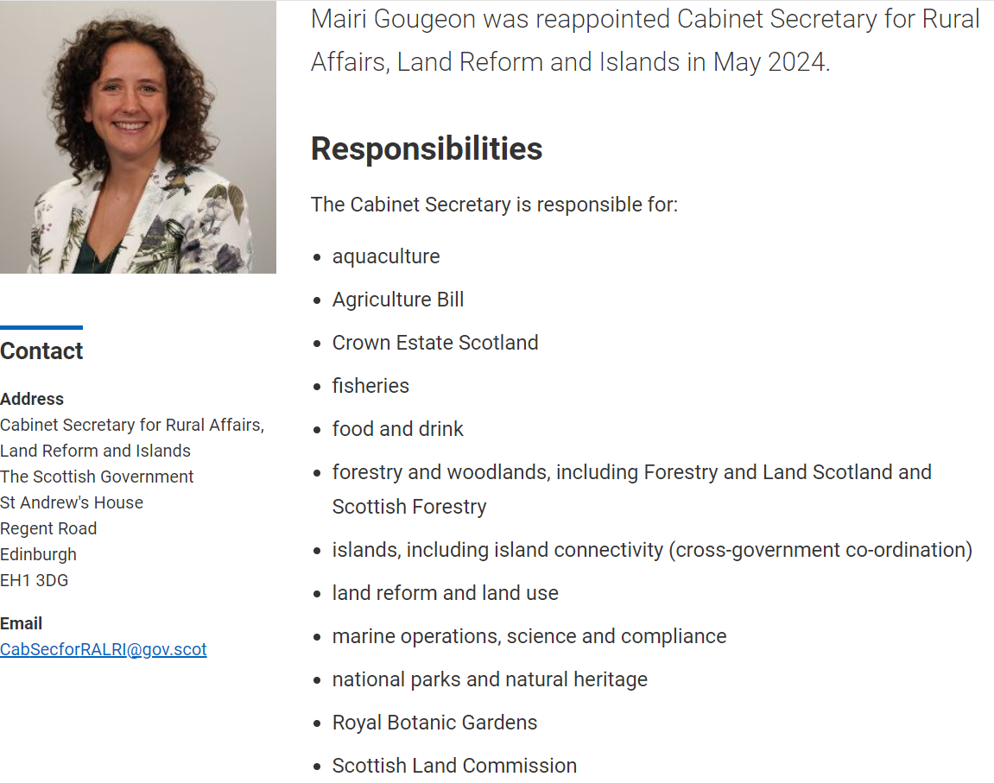

Slide 7
Influencing government + ministers
Priorities are set out in the Programme for Government each September.
Ministers operate under collective responsibility.
Most engagement with government will be reactive (e.g. responding to consultations).
But as stakeholders we do have access – and approaches such as site visits can be effective ways of raising issues.
LINK have regular meetings with key Ministers where members can raise issues.

Slide 8
Current issues
Natural Environment Bill
Agriculture Bill
Land Reform Bill
Budgets
Circular Economy Bill

Slide 9
Influencing Other MSPs
Opposition and backbench MSPs play an important role in scrutinising government.
Engaging with MSPs can be an effective way of putting pressure on the government or raising the profile of issues.
MSPs will be most likely to engage if they have a committee or portfolio interest, or the issue has relevance in their constituency.
Nature Champions scheme builds prominence of nature across parliament.
We can ask MSPs to do things! (Motions, PQs, etc.)

Slide 10
What can Backbench msps do?
Parliamentary questions (written + oral)
Motions
Debates
Members business debates
Amendments to legislation
Letters to Ministers
Events (e.g. conference fringe events)
Media interventions

Slide 11
Parliamentary questions
What are they?
MSPs can submit written questions at any time, or ask oral questions in the chamber.
“To ask the Scottish Government…”
Why use them?
Puts information into public domain
Can access new stats/info
Can (quietly) get issues on agenda of Ministers + officials
Downsides?
Written questions can take up to 20 working days to be answered.
Answers aren’t always useful!

Slide 12
Motions
What are they?
Written statements submitted by MSPs to express a view on a topic, which other MSPs can sign
Why use them?
MSPs use motions to express views or highlight local issues
Some motions can be submitted for debate
Can help identify friendly MSPs
Downsides?
Not very effective advocacy tools (unless drafted for Members’ Business)
Strange format for those unfamiliar

Slide 13
debates
What are they?
The Parliament regularly debates, and then votes on, motions proposed by the government or opposition parties.
Members’ Business debates are lower profile and aren’t voted on – but require a Government response.
Why use them?
Highest profile activity in parliament (alongside FMQs)
Briefing MSPs for debates can be useful way of having our arguments heard
Members’ Business can raise our issues directly – even the niche
Downsides?
Short timescale for knowing what issues will be debated

Slide 14
Cross-party groups
What are they?
MSPs can choose to start or join cross-party groups, where MSPs and outside organisations or individuals regularly discuss issues.
LINK involved in 2 – the CPG on Nature and Climate, and the CPG on Circular Economy.
Why use them?
Direct access to MSPs with particular interest in your topic
Chance for cross-party engagement in more educational atmosphere than parliament.
Downsides?
Only as good as the work that goes into them
Don’t expect massive turn-out

Slide 15
Lobbying register
Remember – some advocacy with MSPs, Ministers, or Special Advisors needs to be recorded on the Lobbying Register.
If you don’t know if this applies to you, check lobbying.scot

Slide 16
Q&A
Nora Casey, Parliamentary Officer, RSPB Scotland
Simon Ritchie, Policy and Advocacy Manager Woodland Trust Scotland
Claudia Beamish, LINK Honorary Fellow and Former MSP

